Slide 1


Facial Emotion Detection
Jeff Stearns

Slide 2
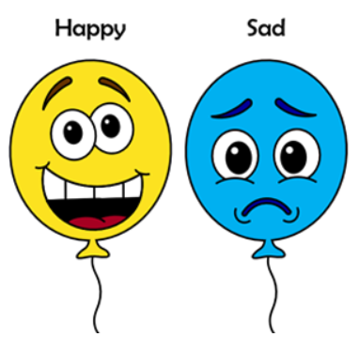



PROBLEM DEFINITION
Can emotion be accurately detected by Convolutional Neural Networks (CNN)?
Self driving car, detect drowsy or distracted.
Potentially assist with security: Predict dangerous behaviors by reading emotions.
Detect emotional response of customers to advertisement.

Slide 3
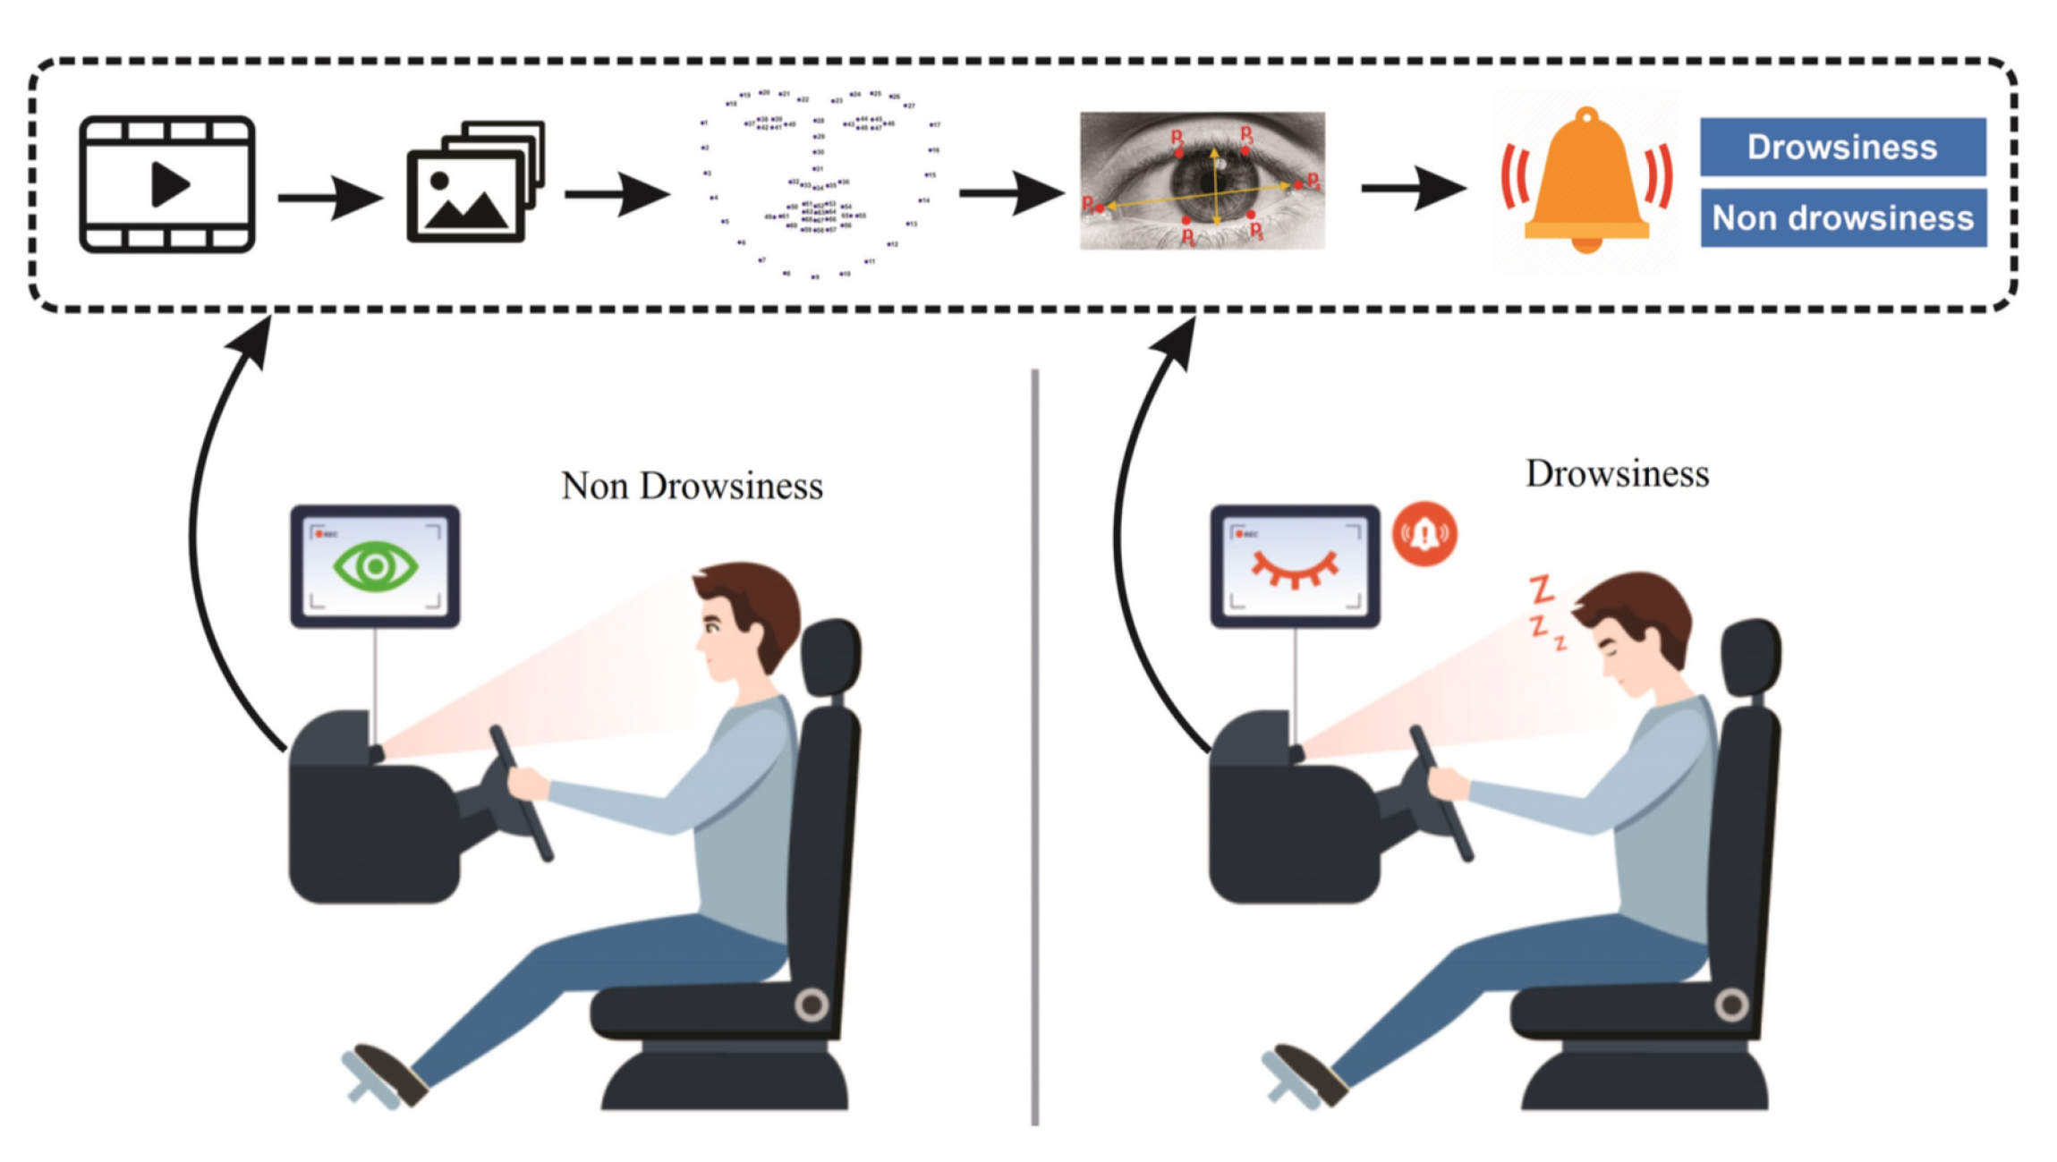
FACIAL EMOTION DETECTION USE CASE 1
Autopilot Automobiles : Driver alertness still required, sensors and software are not perfect.

Slide 4
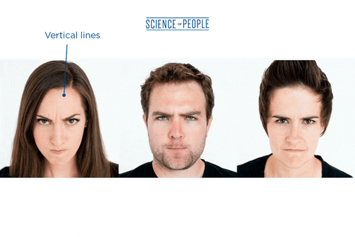
FACIAL EMOTION DETECTION USE CASE 2
Security alert, detect potentially dangerous individual through emotion recognition.

Slide 5
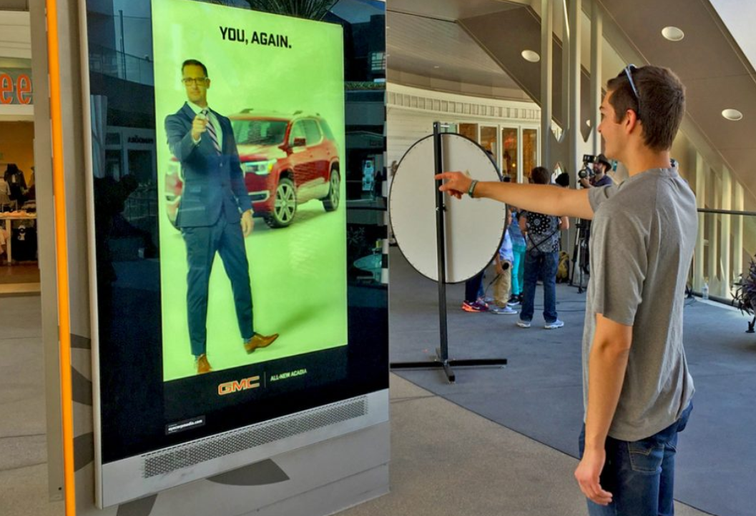
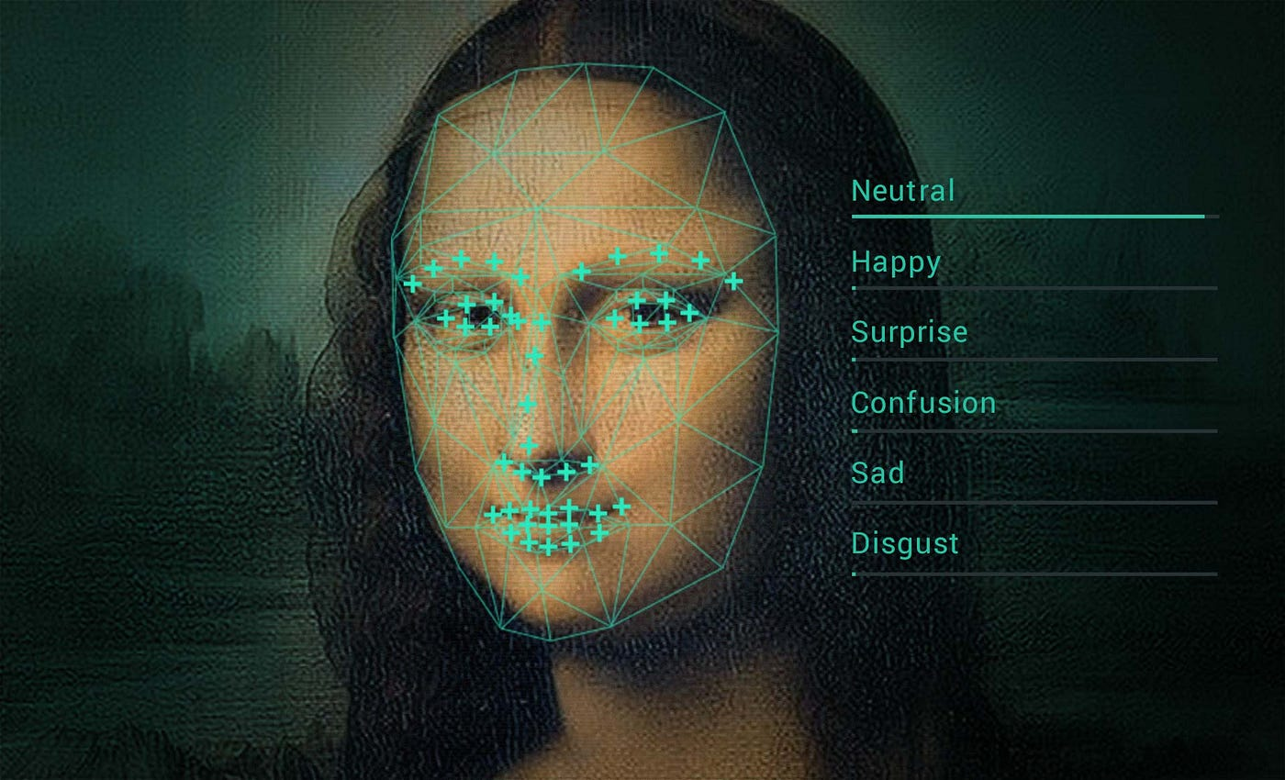
FACIAL EMOTION DETECTION USE CASE 3
Detect emotional response of customers to advertisement.

Slide 6




DATA SET ANALYSIS
Facial_emotion_images.zip
Black and White Images : 48 Pixel Squares
Example Images
Happy
Neutral
Sad
Surprise

Slide 7
DATA SET ANALYSIS
20,214 Grayscale Images, 48 Pixel Square
Very small TEST set : 60-80 / 10-20 / 10-20 standard ratios
TRAINING | VALIDATION | TEST
Happy 3976 26.3% Sad 3982 26.4% Neutral 3978 26.3% Surprise 3173 21.0% | Happy 3976 36.7% Sad 3982 22.9% Neutral 3978 24.4% Surprise 3173 16.0% | Happy 32 25.0% Sad 32 25.0% Neutral 32 25.0% Surprise 32 25.0%
15109 74.7% | 4977 24.6% | 128 0.006%

Slide 8







DATA SET ISSUES
No face, watermark, multiple face, cartoon, etc…
train\happy
train\sad
test\happy

Slide 9
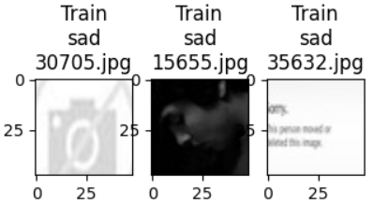
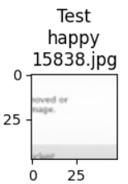
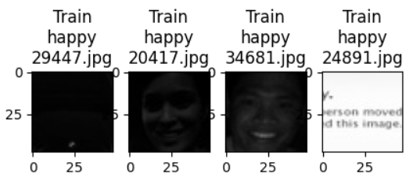
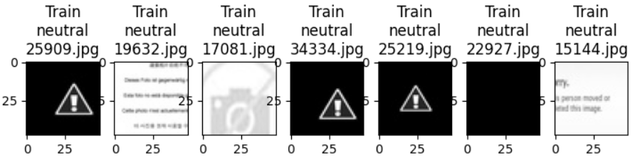
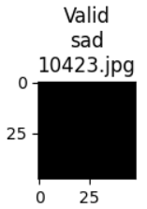
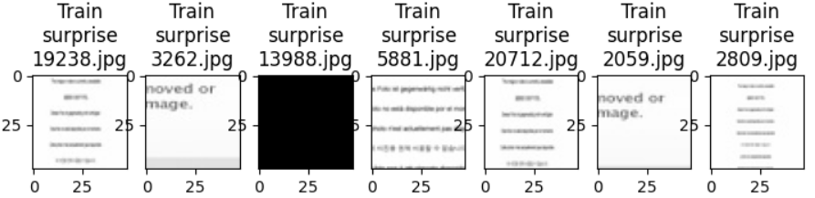
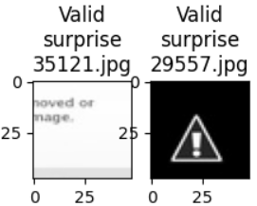
DATA SET IMAGES, NO FACE or TOO DARK
Filter Tool : Reject Images Numpy.Average<20 or >235
25 Images : 21 Train, 3 Validation, 1 Test

Slide 10
CONVOLUTIONAL NEURAL NETWORK (CNN) MODELS
MODEL | LAYERS | PARAMETERS | COMMENT
Grayscale 1 | 5 : 3 Conv2d | 605,060 | Lowcode Model
Grayscale 2 | 6 : 3 Conv2d | 389,604 | BatchNormalization, Dense
VGG16 | 16 : 13 Conv2d | 14,714,688 | Transfer Model 1, RGB Images
ResNetV2 | 16 : 13 Conv2d | 42,658,176 | Transfer Model 2, RGB Images
EfficientNet | 16 : 13 Conv2d | 8,769,374 | Transfer Model 3, RGB Images
Milestone 1 | 7 : 4 Conv2d | 1,592,324 | Kernel Size 3 & 2, Conv2D added
CapStone | 8 : 5 Conv2d | 2,973,700 | Conv2D Layer Added

Slide 11
DATASET LOADERS
TENSORFLOW TOOLS
ImageDataGenerator : Image Augmentations Applied
flow_from_directory method
rescale : Normalize pixel values 0-1
horizontal_flip : Teach model differing orientations
rotation_range : Handle random rotation of images
Read data, labels from directory structure
Easier to load and process data in batches

Slide 12
CNN MODEL 1
Low Code Notebook Model
We want our Base Neural Network architecture to have 3 convolutional blocks.
Each block contains one Conv2D layer, maxpooling layer and Dropout layers.
Add first Conv2D layer with 64 filters and a kernel size of 2, 'same' padding input shape = (48, 48, 1) if you're using 'grayscale' colormode. Use 'relu' activation.
Add a second Conv2D layer with 32 filters and a kernel size of 2, 'same' padding and 'relu' activation.
Add a third Conv2D layer with 32 filters and a kernel size of 2, 'same' padding and 'relu' activation.
After adding your convolutional blocks, add your Flatten layer.
Add your first Dense layer with 512 neurons. Use 'relu' activation function.
Add a Dropout layer with dropout ratio of 0.4.
Add your final Dense Layer with 4 neurons and 'softmax' activation function
Print your model summary

Slide 13
CNN MODEL 2
Enhanced Low Code Notebook Model
Conv2D Layer Added
Dense Layer Added
More Neurons per Conv2D Layer
BatchNormalization Added

Slide 14
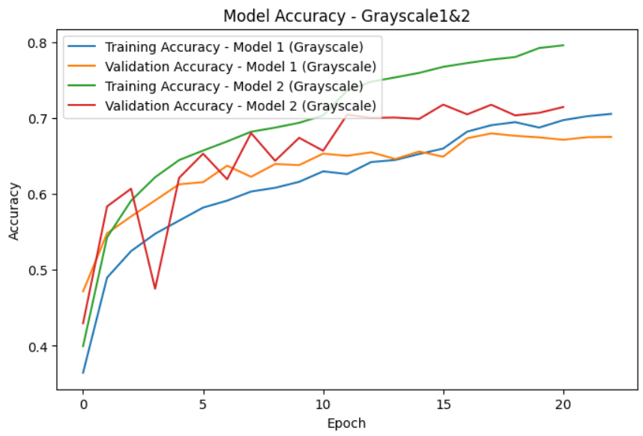
CNN MODELS 1 & 2 GRAPH

Slide 15
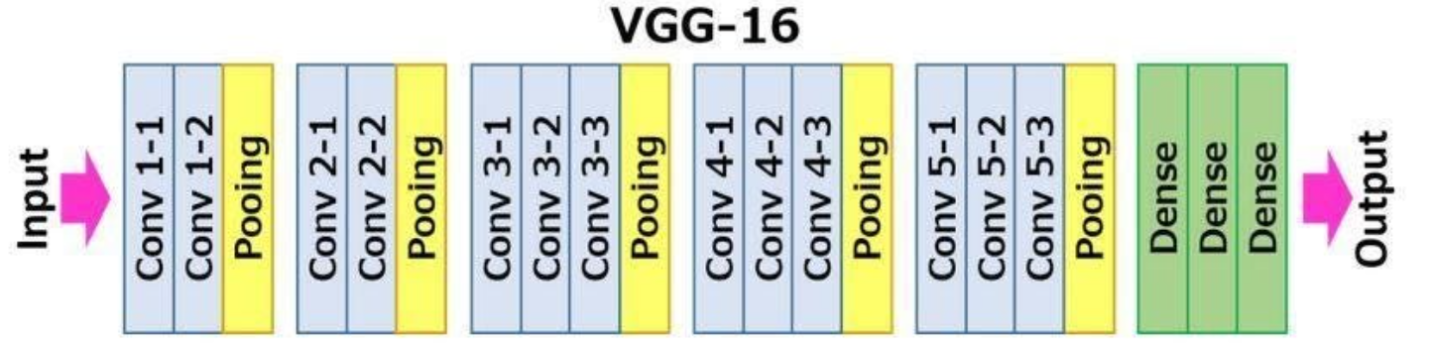
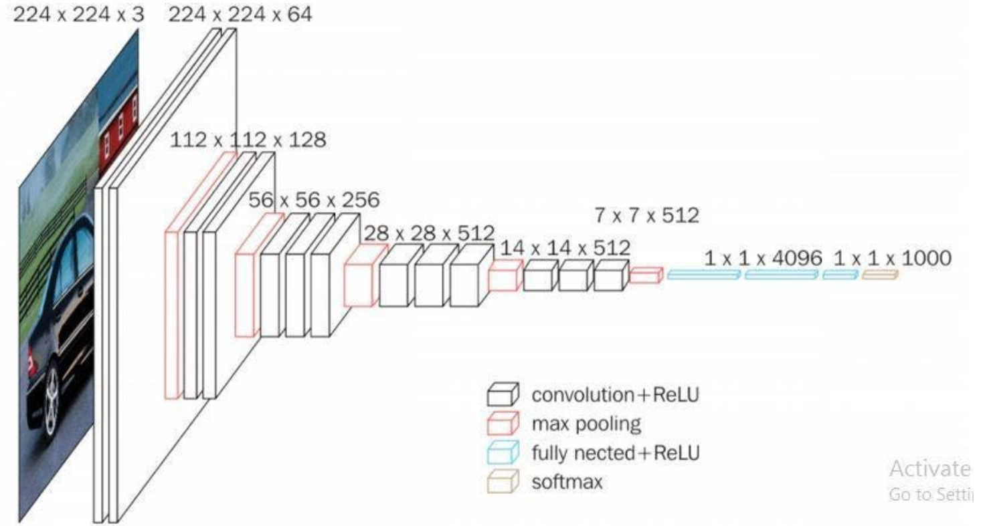
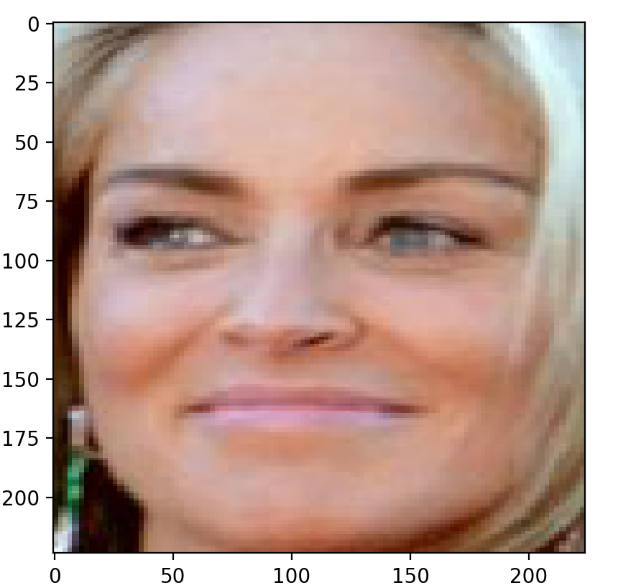
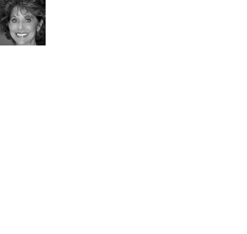
VGG-16 ARCHITECTURE
VGG16 Image vs Facial_emotion_images
65 to 1 Image Data

Slide 16
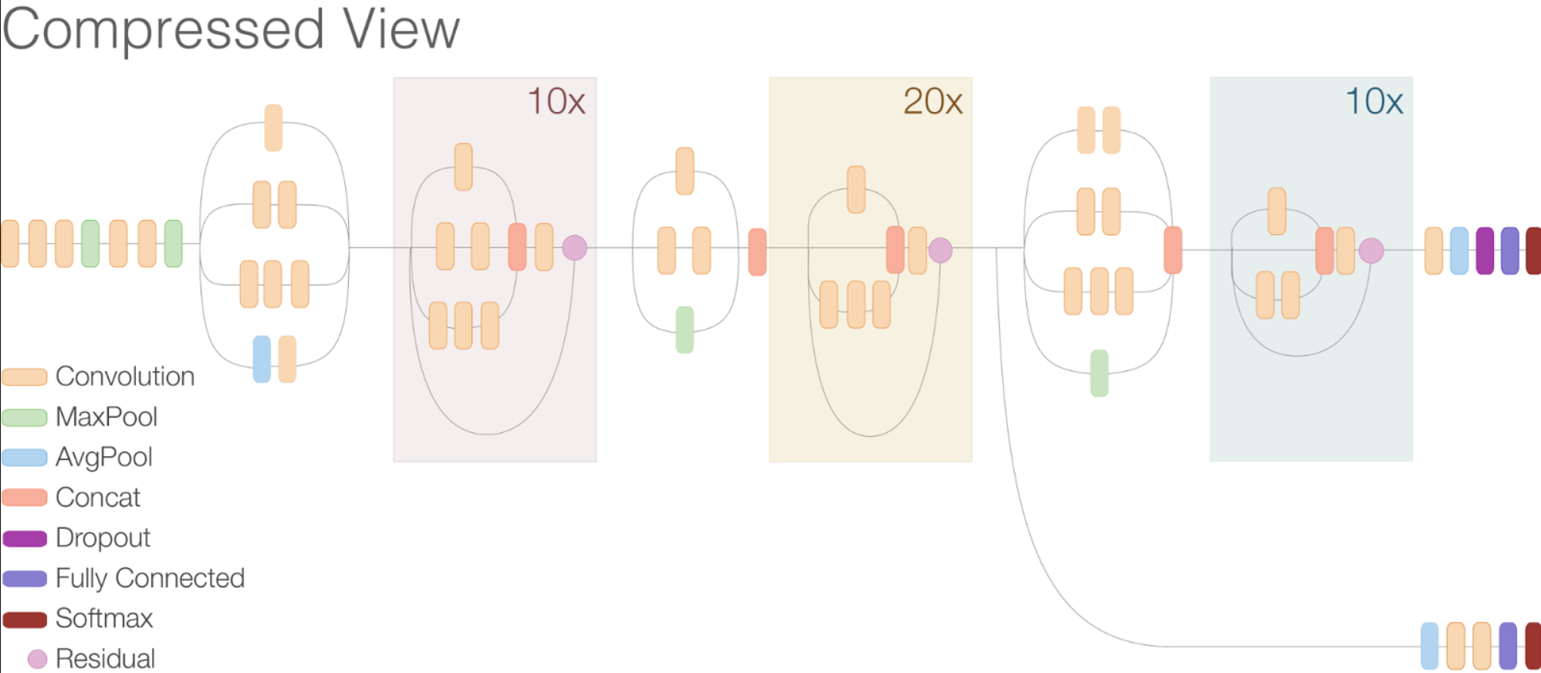
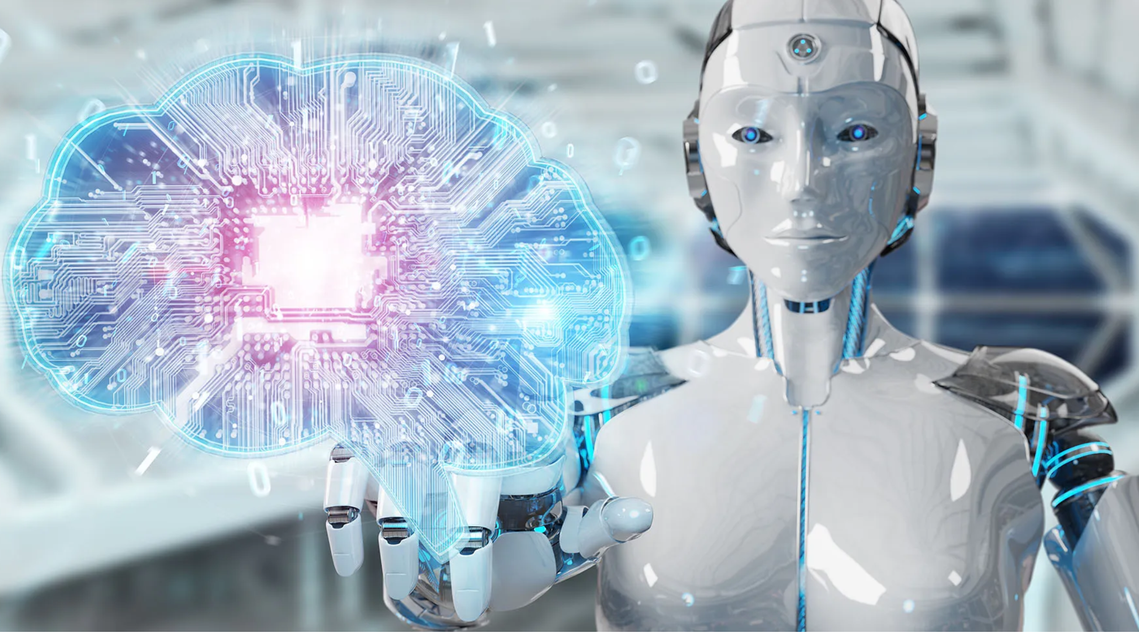
ResNetV2 ARCHITECTURE
42,658,176 Parameters
Poor performance on Dataset

Slide 17
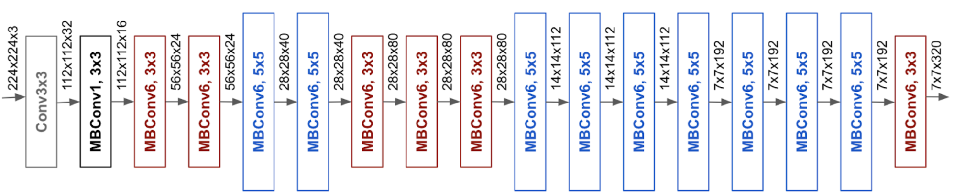
EFFICENTNET ARCHITECTURE
8,769,374 Parameters
Poor performance on Dataset

Slide 18
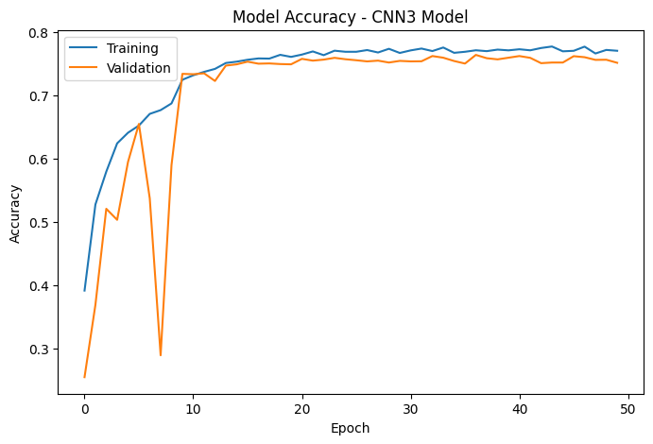
MILESTONE 1 MODEL
Enhanced Version 3 CNN Model
Conv2D Layer Added
More Neurons per Conv2D Layer
Data Loader Augmentation Hyperparameter adjustments
Validation accuracy dips to in Epoch 8?

Slide 19
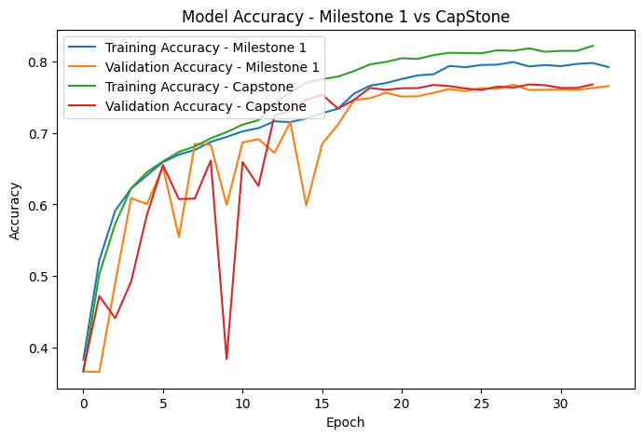
CAPSTONE MODEL
Final CapStone Model Version
Conv2D Layer Added
More Neurons per Conv2D Layer
More parameters : 2,973,700

Slide 20
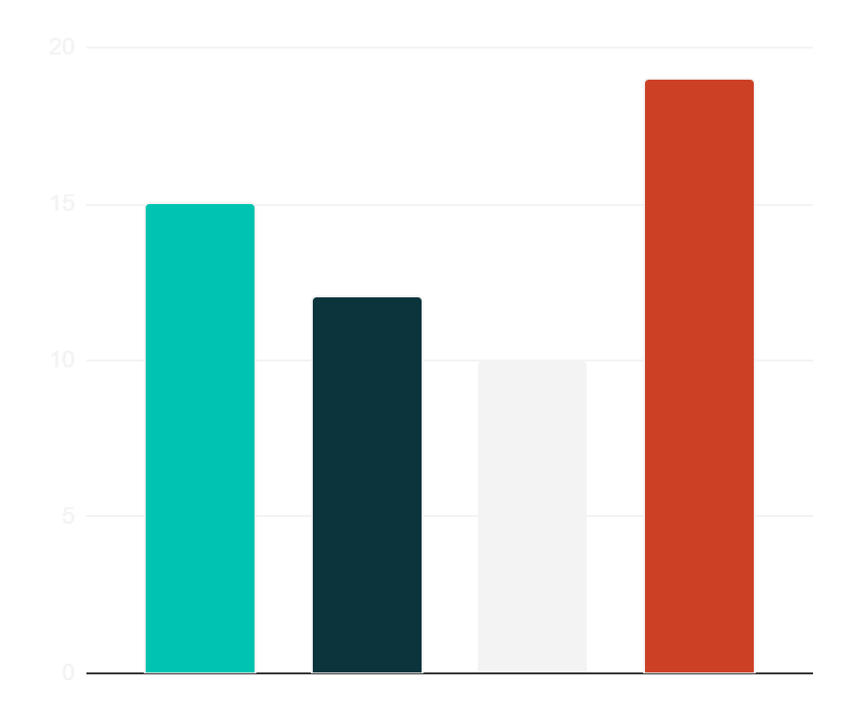
AI TECH AGENCY INFOGRAPHICS
OUR SCHEDULE
12h
JUPITER
Jupiter is a very big planet
19h
VENUS
Venus has a toxic atmosphere
15h
MARS
Mars was named after a god
Jupiter
Venus
Mars
Mercury
10h
MERCURY
Follow the link in the graph to modify its data and then paste the new one here. For more info, click here
Mercury is a small planet

Slide 21
AI TECH AGENCY INFOGRAPHICS
PLANNING
 | MON | TUE | WED | THU | FRI
08:00 | Insert your own text | Insert your own text | Insert your own text | Insert your own text | Insert your own text
10:00 | Insert your own text | Insert your own text | Insert your own text | Insert your own text | Insert your own text
12:00 | Insert your own text | Insert your own text | Insert your own text | Insert your own text | Insert your own text
2:00 | Insert your own text | Insert your own text | Insert your own text | Insert your own text | Insert your own text

Slide 22
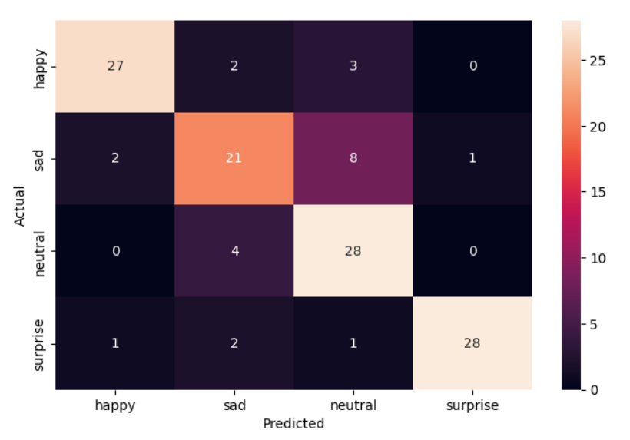
FINAL MODEL HEATMAP
PREDICTED RESULTS vs ACTUAL (Folder)

Slide 23
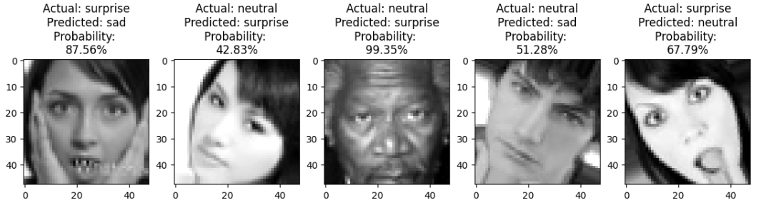
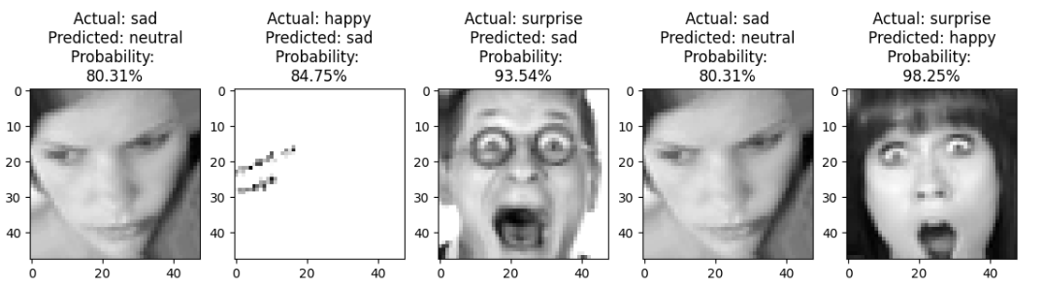
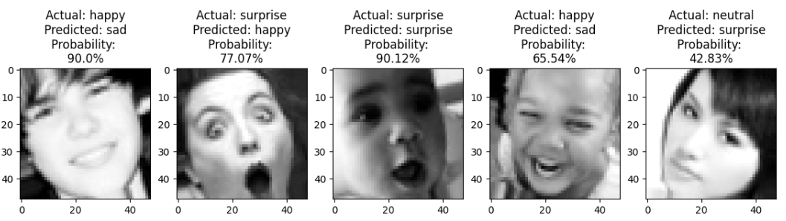
FINAL MODEL MISMATCH IMAGES

Slide 24
FINAL CNN MODEL ANALYSIS
 | Parameters | Train Accuracy | Train Loss | Val Accuracy | Val Loss | Test Accuracy | Test Loss
Model 1: Grayscale 1 | 605,060 | 0.706 | 0.725 | 0.68 | 0.79 | 0.62 | 0.81
Model 2: Grayscale 2 | 389,604 | 0.796 | 0.496 | 0.715 | 0.74 | 0.68 | 0.68
Model 3: VGG16 | 14,714,688 | 0.72 | 0.687 | 0.675 | 0.815 | 0.72 | 0.71
Model 4: ResNet V2 | 42,658,176 | 0.27 | 1.38 | 0.36 | 1.37 | 0.25 | 1.40
Model 5: EfficientNet | 8,769,374 | 0.27 | 1.38 | 0.37 | 1.35 | 0.25 | 1.41
Model 6: Grayscale 3 | 1,592,324 | 0.80 | 0.51 | 0.77 | 0.60 | 0.805 | 0.543
Model 7: Grayscale 4 | 2,973,700 | 0.83 | 0.44 | 0.77 | 0.65 | 0.77 | 0.60

Slide 25
CONCLUSIONS
Less complex models work better with Facial_emotion_images
Transfer learning models mediocre to poor on dataset
Numerous Use cases for facial emotion detection
Self driving car, detect drowsy or distracted.
Potentially assist with security: Predict dangerous behaviors by reading emotions.
Detect emotional response of customers to advertisement.

